Slide 1
PROJECT REPORT
1 INTRODUCTION
The Navigation Panel on the left-hand side lists all the modules of Zoho Books.
Get into the Sales tab and the Purchases tab to manage Quotes, Invoices, Expenses, Bills, and more.
The Quick Create button by the respective modules is the shortcut to create new transactions.
The Quick Create option can be used to create a transaction on the fly from anywhere in Zoho Books.
Clicking on the Recent Activities option will display of list of most recent transactions you have carried out in your organization.

Slide 2
Preparation and Maintanence of ZOHO Books for Dream Homes Realty
Dream Homes Realty, a construction company, uses Zoho Books to track project expenses, manage subcontractor payments, and handle invoicing. They can generate estimates and invoices for clients, track job costing, and monitor the profitability of each project.
Zoho Books provides them with financial insights to make informed decisions.

Slide 3
PROBLEM DEFINITION & DESIGN THINKING
It is created method of preparation of Accounting profit and loss account , balance Sheet and GST calculation is completed.
In recent day’s new technologies allotted. Here we use Zohobook as a tool for creating Profit and loss account, balance sheet and GST report.
2.1 Empathy Map
2.2 Ideation & Brainstroming Map

Slide 4
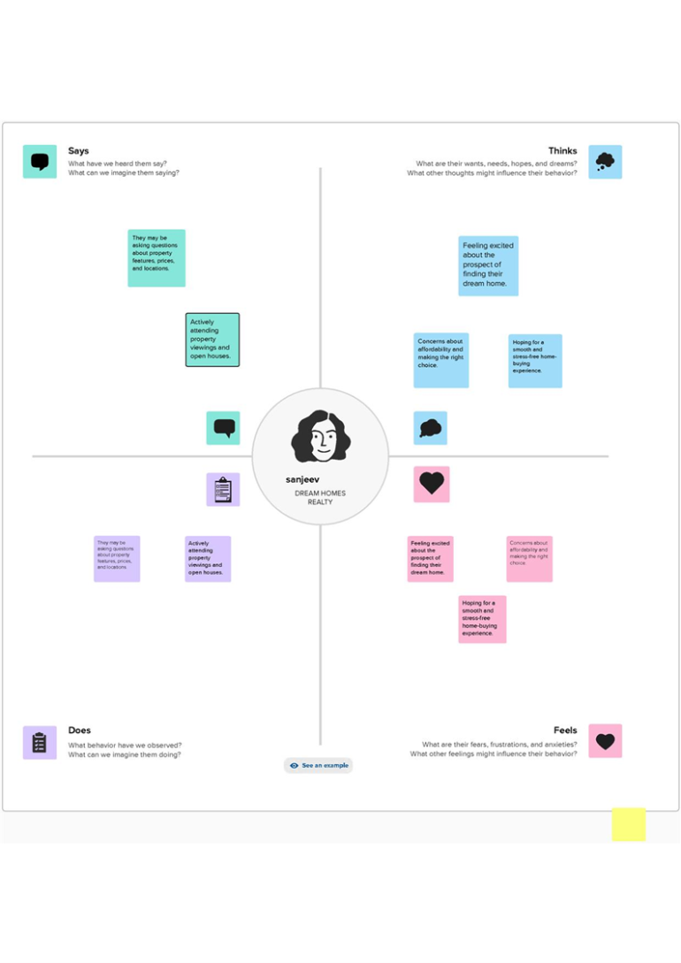
Empathy Map

Slide 5
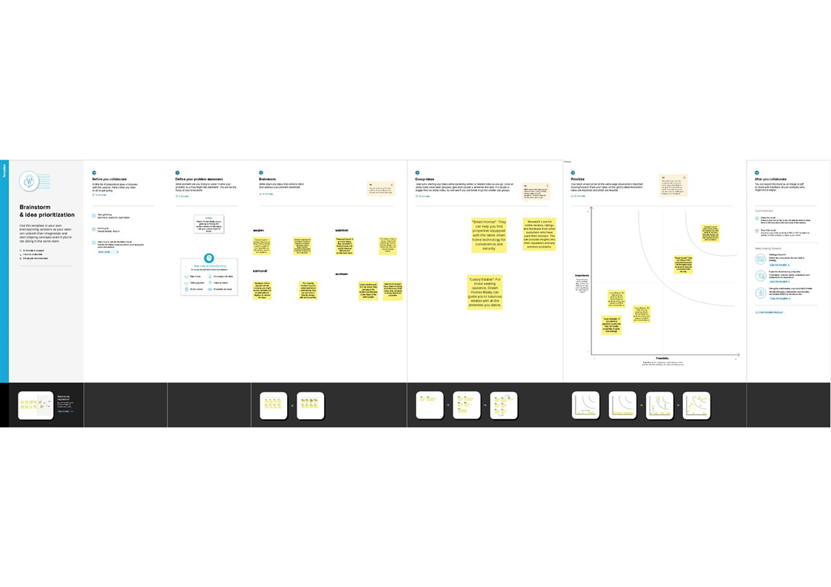
RESULT Output: 1.Company Name Creation:

Slide 6
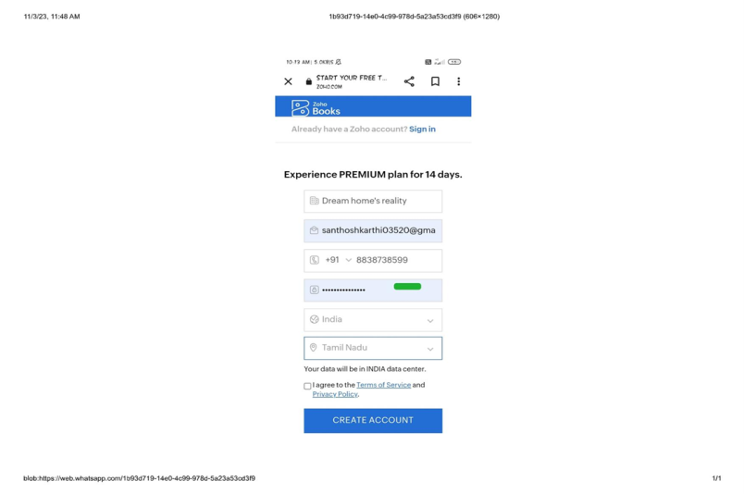
We have to create our Company Name And other Details From Below Zohobooks
2. Item Creation: We have to create items, Such as
➢ Item names
➢ Units
➢ HSN/SAC
➢ Selling info/Purchase info
➢ Tax Rate

Slide 7
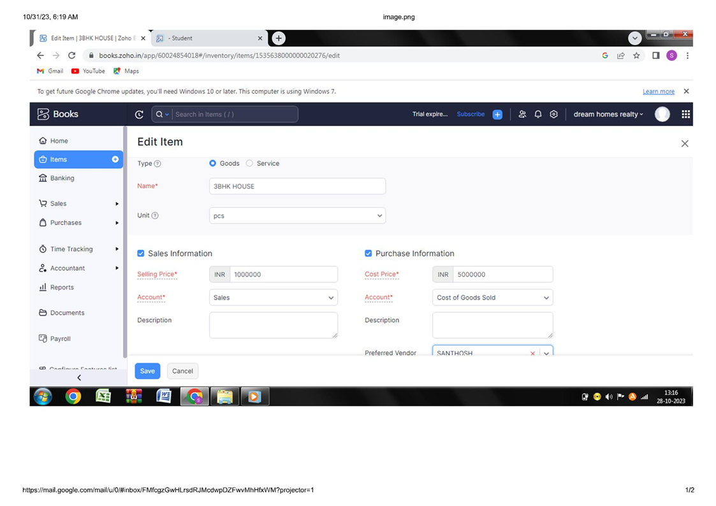
Item Creation

Slide 8
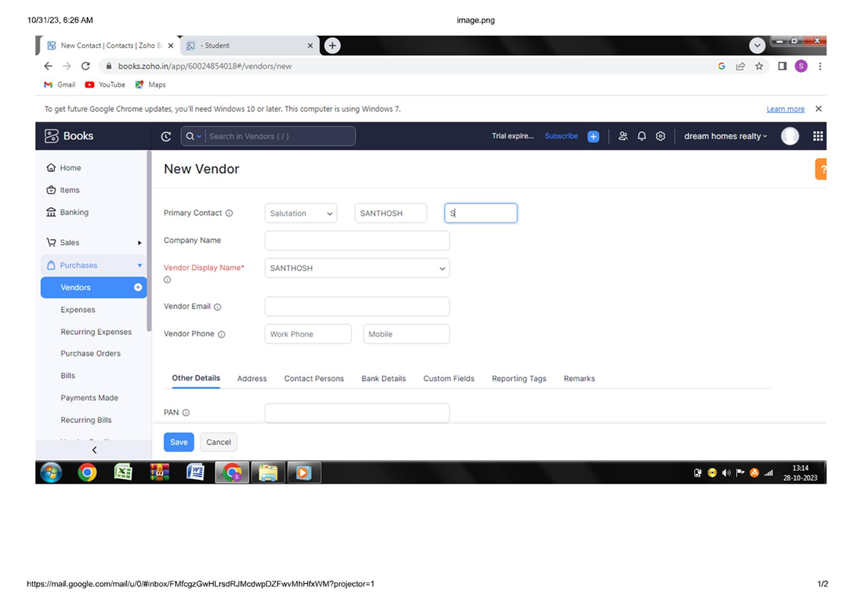
3. Vendor Creation: Now create Vendor in books from navigator panel Create New Vendor For example ➢property sales person

Slide 9
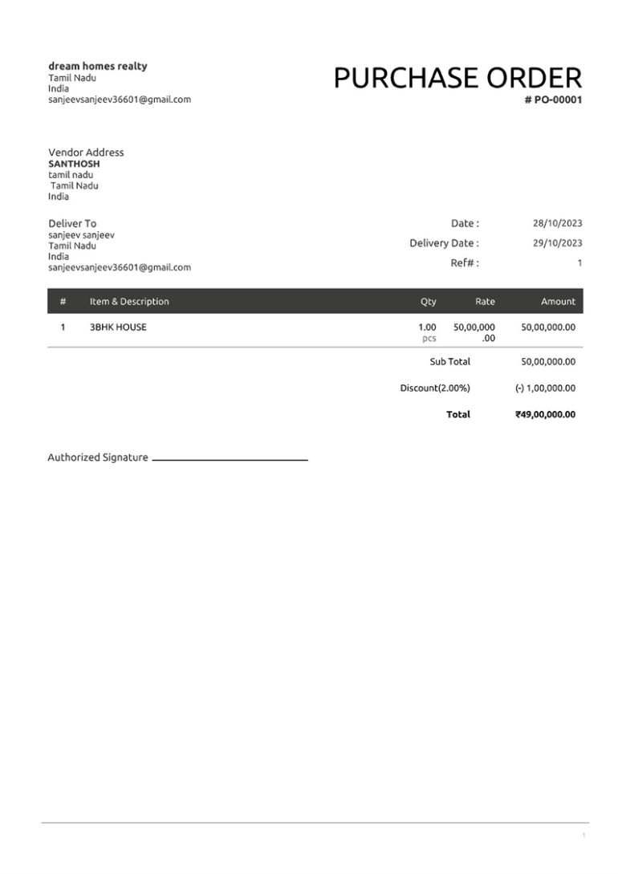
4. Purchase Order: We are creating new purchase order such as below ➢ House sales

Slide 10
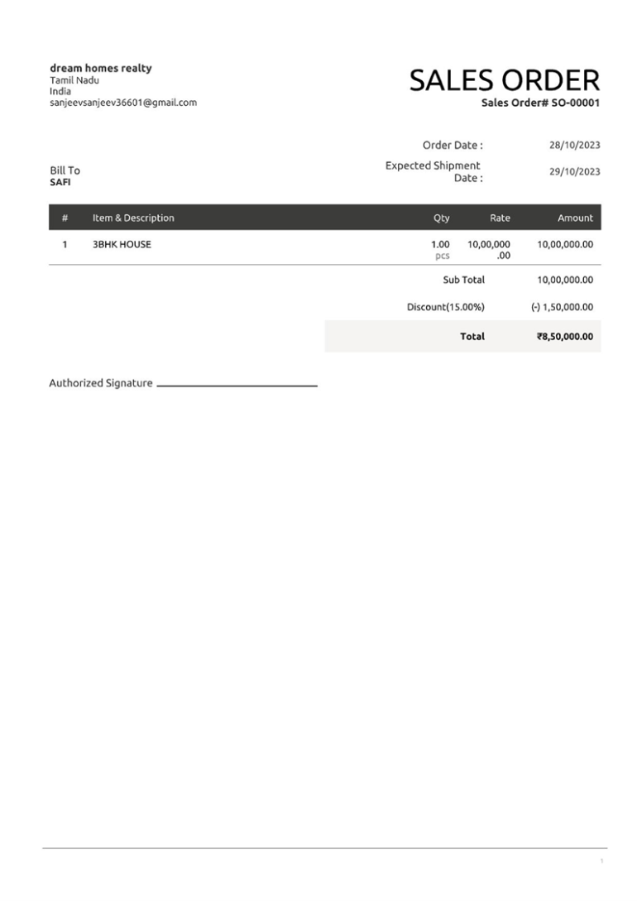
5. Sales Order:

Slide 11
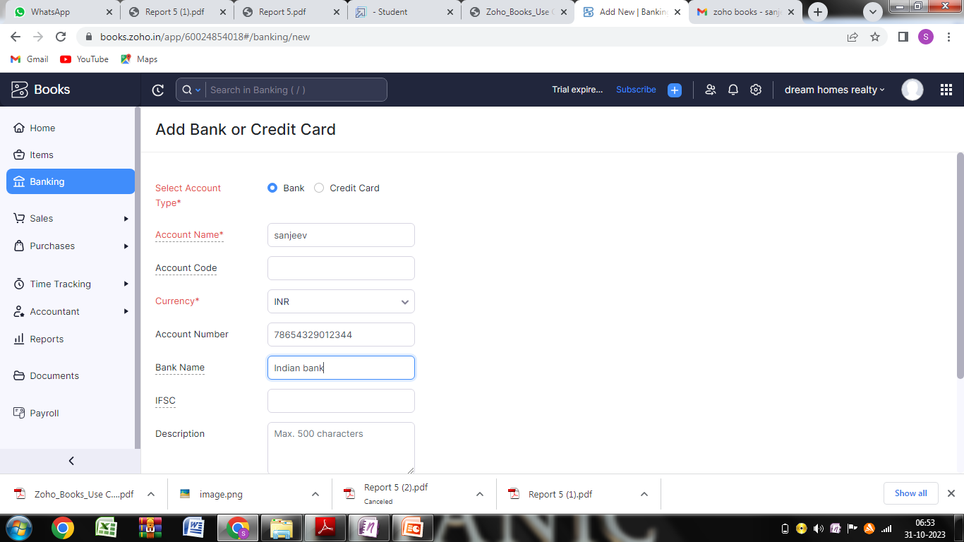
6.Payment to Bank Details: 3BHK HOUSE has opened an account with ICICI bank, to add the bank account And we have to select bank account manually and filled it.

Slide 12
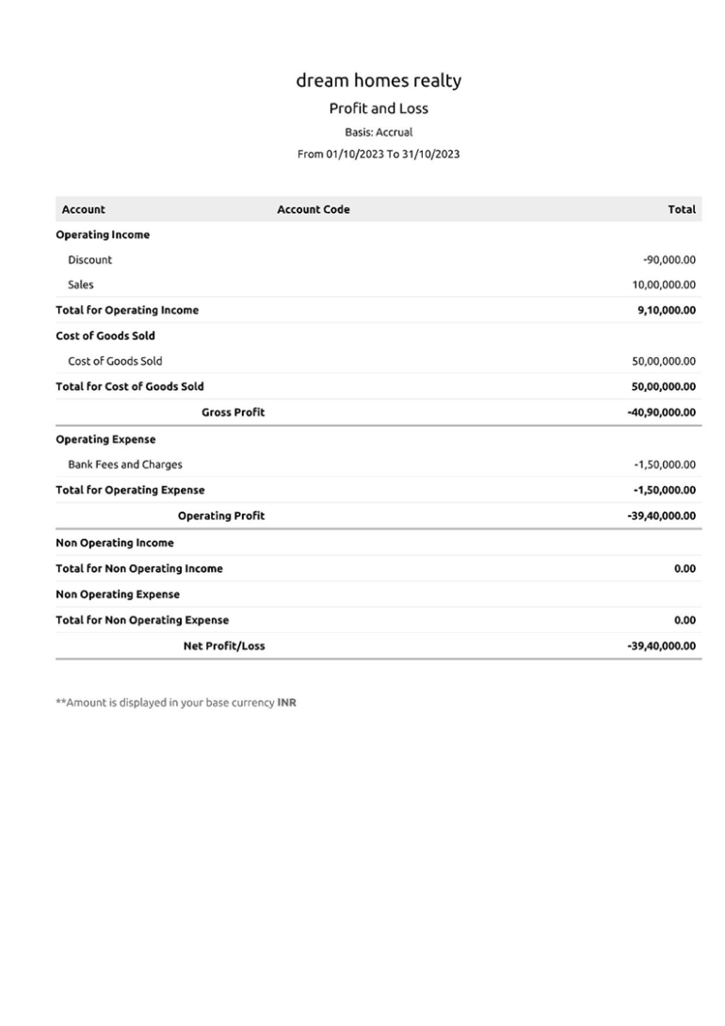
7. Profit and loss Account\ Balance Sheet\GST Report :

Slide 13
4 ADVANTAGE & DISADANTAGE: ADVANTAGE: Easy for Managing day to day activities. DISADVANTAGE: Missing New Version. 5 APPLICATION: This application used to maintain the company details and ledger accounts, profit and loss Account and Balance sheet of the dream homes realty.
6 CONCLUSION:
Dream Homes Realty offers a range of services related to buying, selling, and renting real estate properties. They may have various property types and services available, including residential, commercial, and rental properties. To draw a conclusion, you'd need to specify what particular aspects or types of properties you'd like to explore or compare within their offerings.
7 FUTURE SCOPE:
The future scope for Dream Homes Realty, like any real estate company, largely depends on market trends and their ability to adapt. Key areas of focus for future growth might include embracing digital technologies for property listings and transactions, expanding into emerging real estate markets, incorporating sustainable and eco-friendly housing options, and offering innovative financial solutions to homebuyers. Additionally, providing excellent customer service and building a strong online presence will likely be essential for their continued success.
8 APPENDIX:
➢ Approved development
➢ Future Assessment
➢ Plan of development
➢ Development Purpose
➢ Interpretation

